Slide 1

Presented By:
Shayaan Sadiq, Mohd Abdul Jawaad Hassan, Mohammed Abdul Muqeet, Syed Taufeeq
160923733191, 160923733204, 160923733229, 160923733224
Department of Computer Science Engineering
Lords Institute of Engineering and Technology
LORDS INSTITUTE OF ENGINEERING & TECHNOLOGY
UGC Autonomous Institution
Hyderabad-500091, TS.
Department of Computer Science and engineering
AcadEase – a Unified Parent-Teacher Portal
Guided By:
Ms. Tanwi Mahaboob
Co-coordinator

Slide 2
Introduction
Project Overview: The Parent-Teacher Portal is designed to create a seamless communication bridge between parents and teachers, ensuring transparency and collaboration.
Objective: To facilitate effective communication between parents and teachers by providing an integrated platform.
Motivation: To enhance parent-teacher interactions and foster a supportive environment for student growth and development.

Slide 3
Problem Statement
Identify the Problem: Lack of efficient communication channels between parents and teachers often leads to misunderstandings and missed opportunities for student development.
Relevance: Improved communication can directly impact student performance and strengthen the collaboration between parents and teachers.

Slide 4
Proposed Solution
Description: A web-based platform that allows parents to track their child's progress and enables teachers to address parent concerns effectively.
Key Features:
- Only those who log in through the QR code scanner will be marked present.
- Parents can track attendance, view marks, and apply for leaves.
- Teachers can mark period-wise attendance, access student information, review parent concerns and make announcements.
- Secure and user-friendly interface for seamless interactions.

Slide 5
Tools and Technologies
Programming Languages: Python, Dart
Development Tools: Flask, Flutter, Android Studio
Other Technologies: MySQL for database management

Slide 6
System Design
Components:
Frontend: Dart/Flutter for user interface
Backend: Python/Flask for handling business logic.
Database: MySQL for storing student and teacher data
Architecture/Workflow:
User interacts with Frontend
API calls are made from the Frontend
Necessary data is stored in the database and displayed on the screen

Slide 7
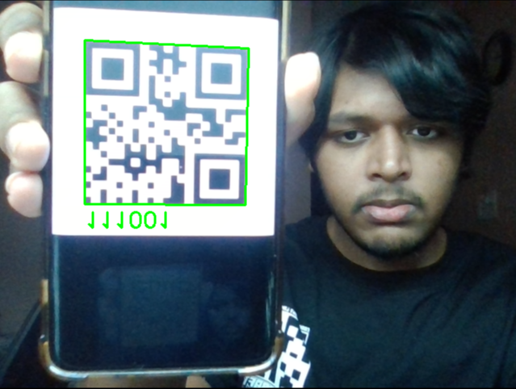
QR Code Implementation

Slide 8
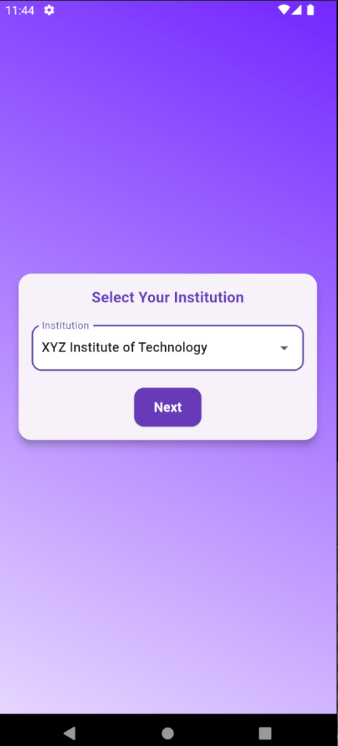
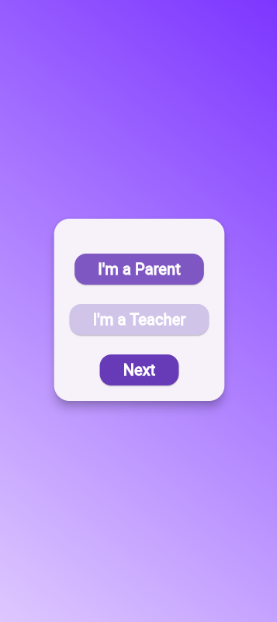
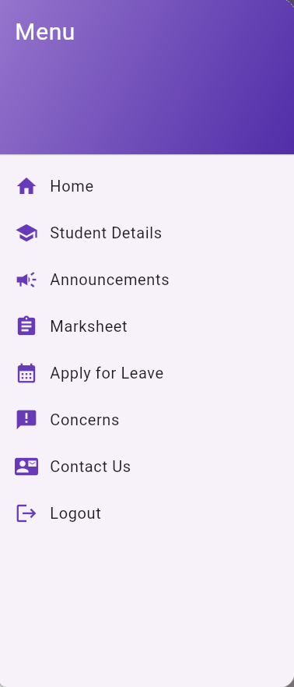
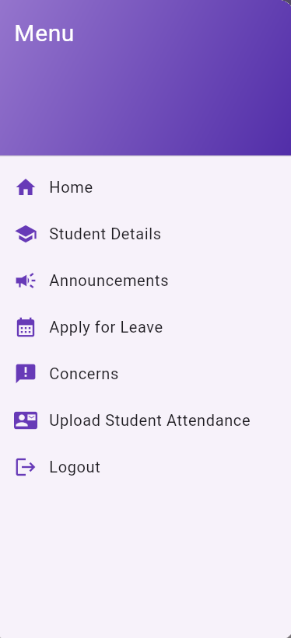
Implementation

Slide 9
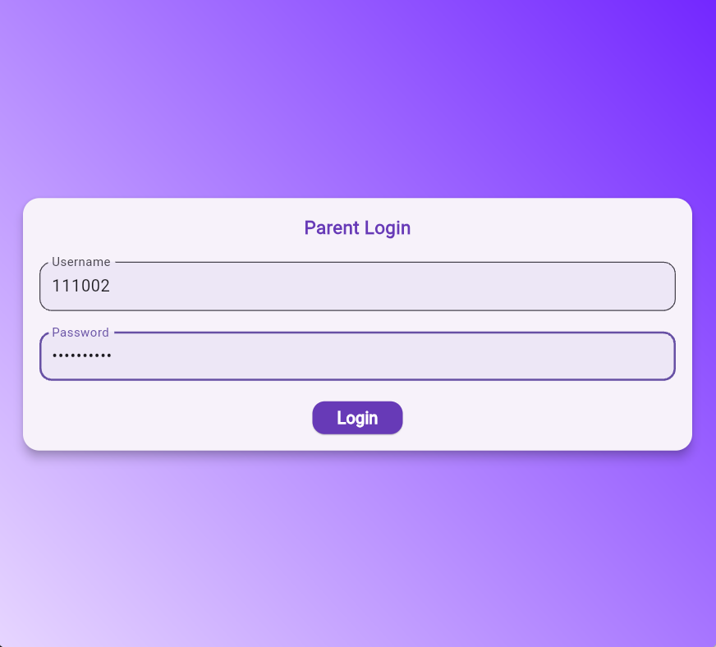
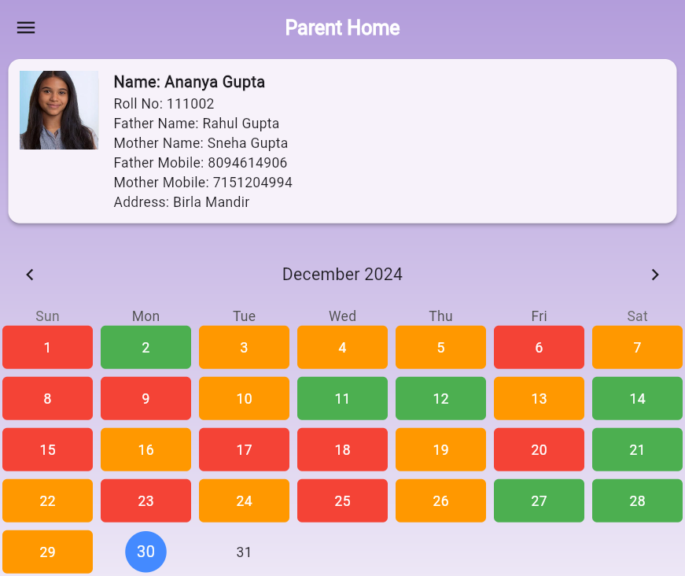

Slide 10
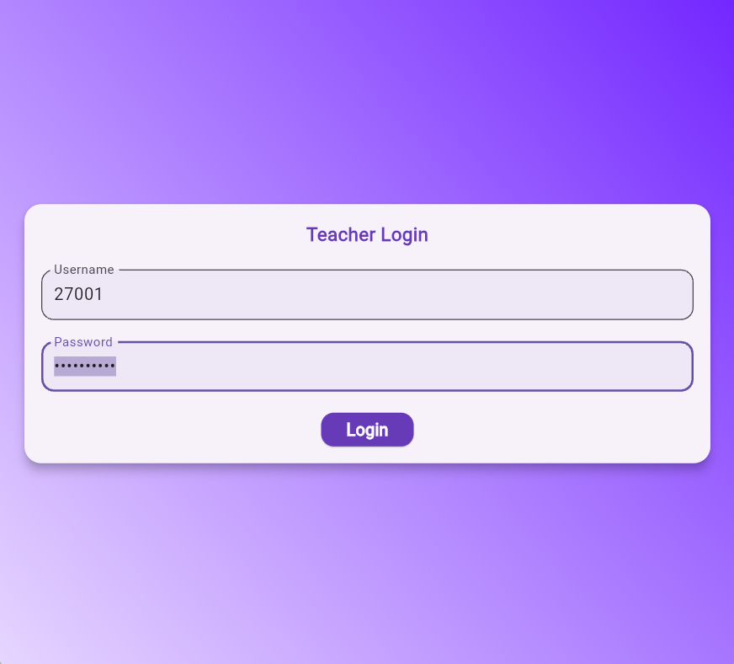
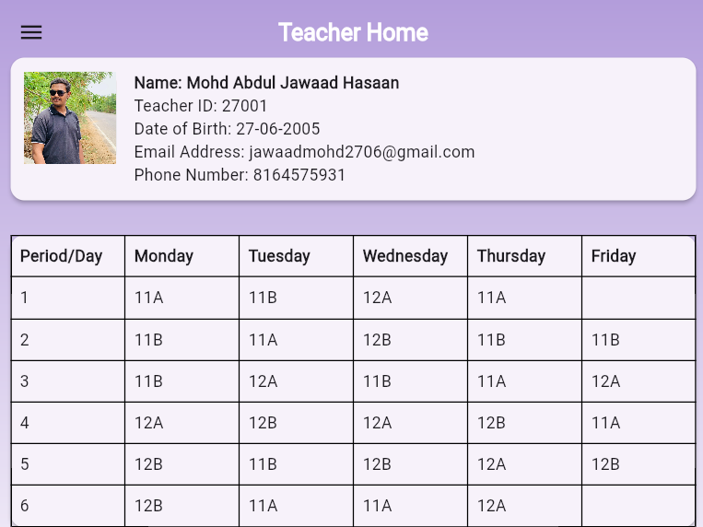

Slide 11
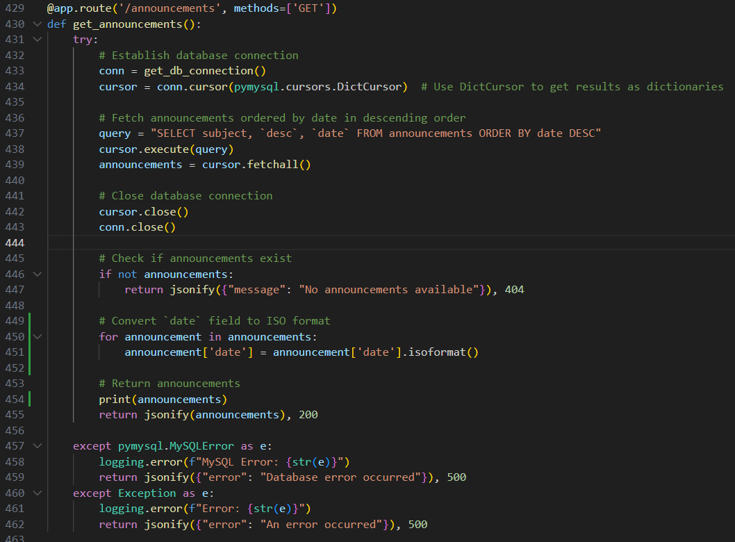

Slide 12
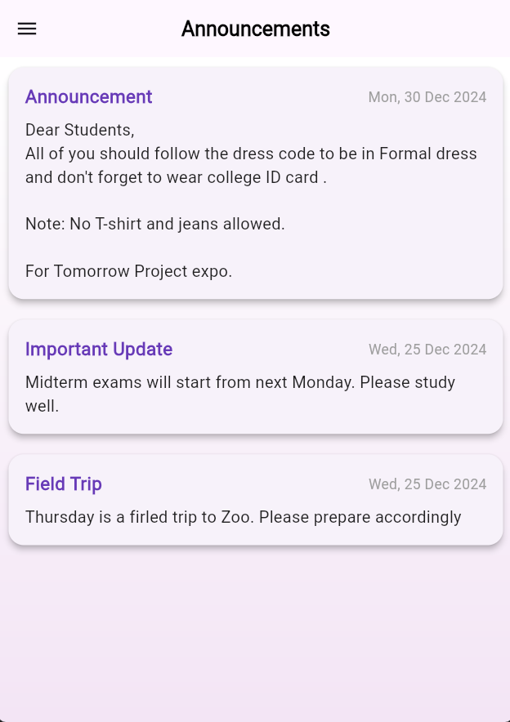
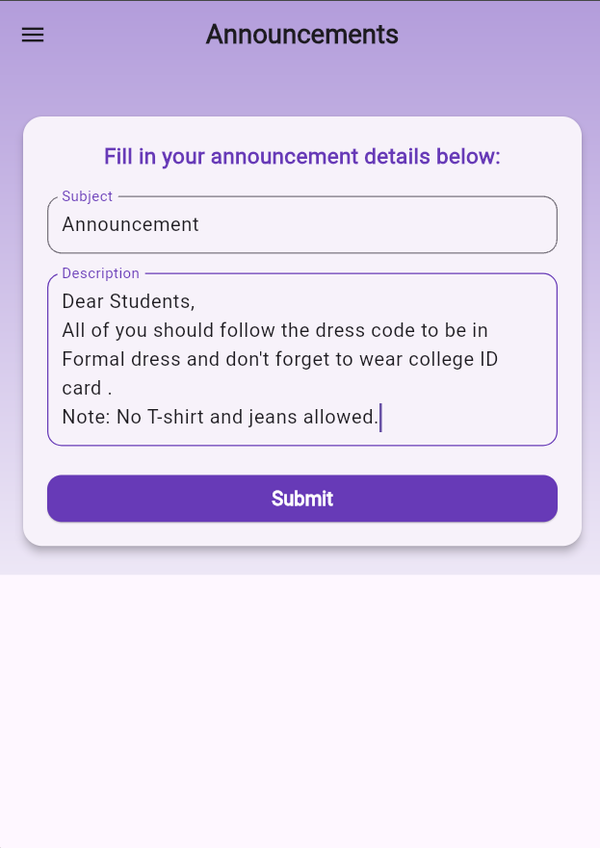

Slide 13
Conclusion
Summary: The Parent-Teacher Portal bridges the gap between parents and teachers, streamlining communication and fostering a collaborative environment.
Key Takeaways: Enhanced understanding of full-stack development, database management, and user-centric design principles.

Slide 14
Future Scope
Enhancements: We can enhance the user interface to make it more intuitive and incorporate additional features, such as feedback forms and online examinations, to improve the overall functionality of the application.
Extensions: The project can be deployed to app stores, allowing it to be accessed by organizations globally. This would enable us to elevate the application to a production-ready level, expanding its reach and impact.

